Slide 1



Feedforward Network for Stock Market Trend Prediction
TEAM MEMBERS:
Mohini Patil (UMID: 32423513)
Nikhil Reddy Kandadi (UMID: 28962694)

Slide 2


Dataset Used
The dataset used contains daily stock prices for major companies and indices, including the S&P 500, AAPL, MSFT, and others.
It is loaded from a CSV file and includes data from before and after September 30, 2015.
Each row = 1 day of market data.
Each column = Closing price for a stock/index on that day.
The data is time-series in nature, i.e., the order of rows (dates) matters.
The main outcome of the code is a prediction of the next day's S&P 500 index value using a neural network.

Slide 3
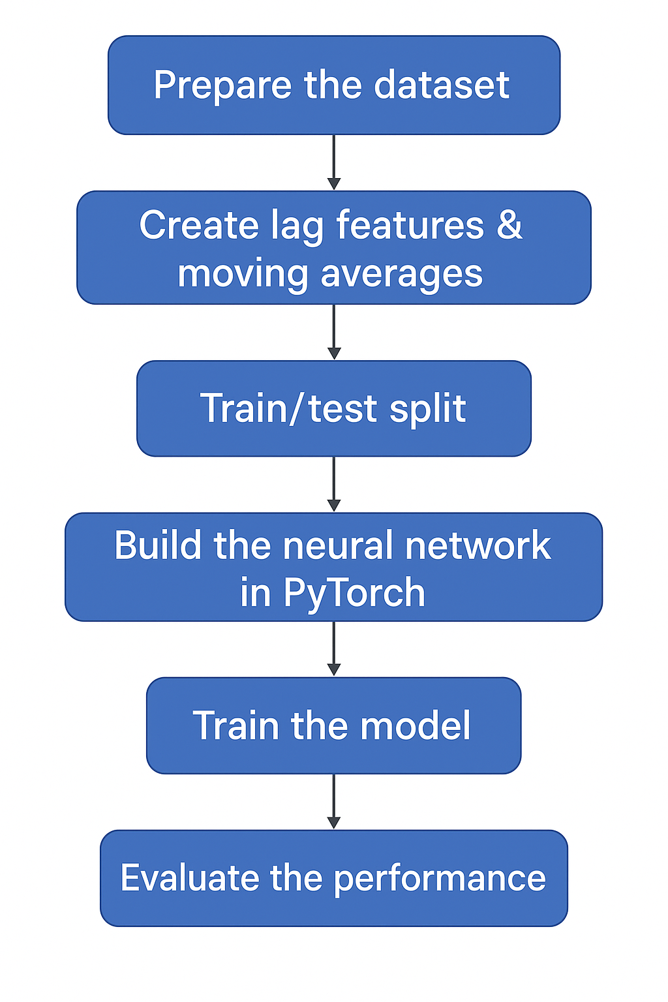
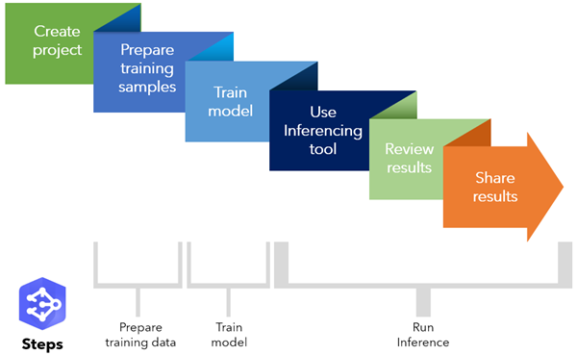

Steps Performed
EDA(Exploratory data analysis) – dive into the provided data to uncover interesting patterns, identify missing values and detect any outliers.
Data Processing – Once we have a clear understanding of the data, we will proceed to clean and preprocess the data set. This will involve handling the missing values and removing the outliers.
Feature Engineering – prepare the features for our machine learning model and then for feedforward neural network.
Model Training - simple feed-forward neural network built using
PyTorch
Model Evaluation - evaluate this model using some matrix also fine tune our
model to ensure that it provides the most accurate predictions.
Visualization - Gives a simple visual overview of stock movement.

Slide 4

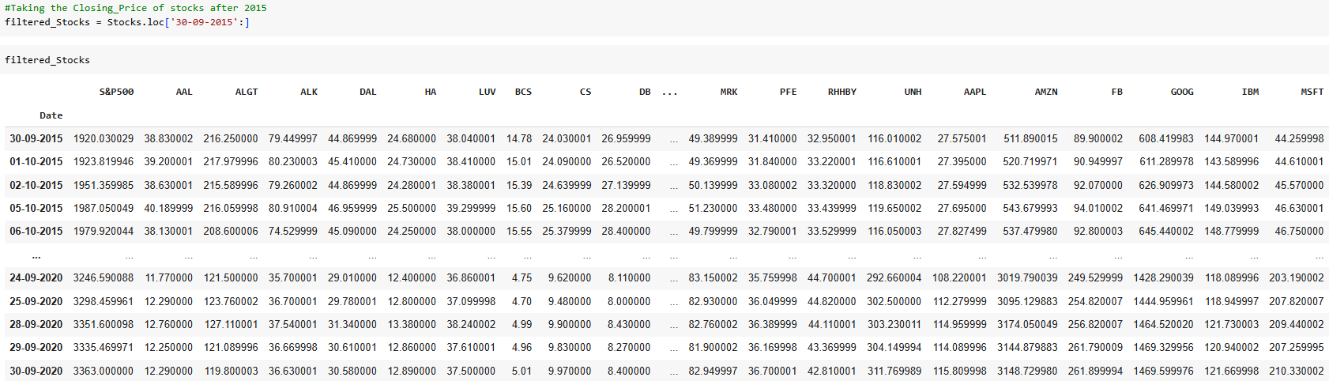
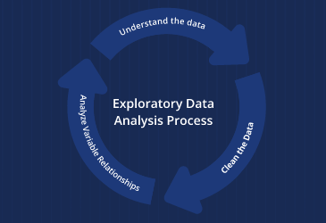

Exploratory Data Analysis
Libraries Used:-
Data manipulation (pandas, numpy)
Machine learning preprocessing (MinMaxScaler, train_test_split)
Deep learning (torch, nn, Dataset, DataLoader)
Visualization (matplotlib, seaborn, mplfinance)
Used Filtered data after 30-Sep-2015
Checked for summary of numeric columns and missing values
Calculated the Relative Strength Analysis and Descriptive Metrics using Annual Returns and Annual Risk- the variables necessary in stock market.

Slide 5

Functions Used To Feed Input Data For Model
Used function prepare_dataset() which
Convert the string to a DataFrame
Parse the dates
Sort the data
Fill any missing values
Return a clean DataFrame for Model Input
create_features()
Have used feature engineering where we used create_features() function to create moving averages, lag features which creates a new column with the stock price from that many days ago. Missing values are filled with the mean of the column.It is used to capture time-series patterns
split_data()
Prepared scaled training and test datasets
StockDataset
Wraps the data into a PyTorch-friendly format for training

Slide 6
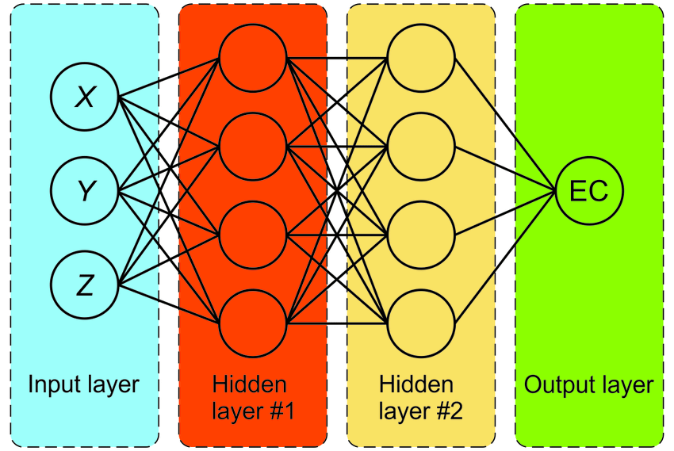
Feed-Forward Neural Network and Model Execution
Create a custom Dataset class:
Easy to use stock data with PyTorch's DataLoader.
Define a simple feed-forward neural network:
Input → Linear(16) → ReLU → Dropout(0.1) → Linear(8) → ReLU → Dropout(0.1) → Output(1)
Define train_model() function:
Uses MSE loss and Adam optimizer to train the model.
Feed in a mini dataset (3 rows):
Using inline CSV data for demonstration with S&P500, AAPL, MSFT, etc.
Prepare dataset and features.
Split into training/test sets, normalize, and create loaders.
Initialize and train the neural network.

Slide 7

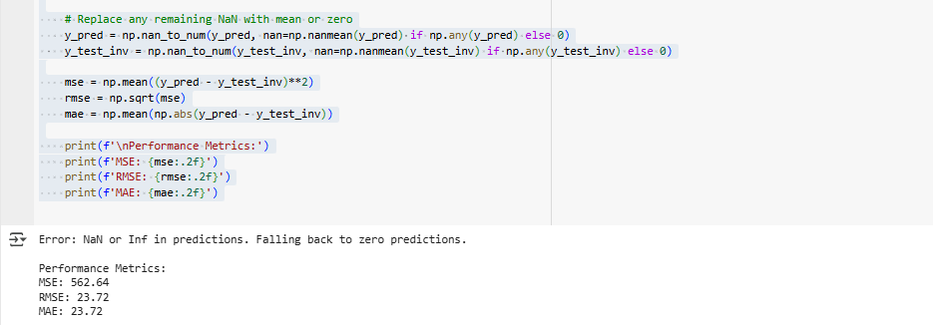
Model Evaluation
Calculated the evaluation Metrics:
MSE (Mean Squared Error): Measures average squared error.
RMSE (Root Mean Squared Error): Square root of MSE, more interpretable.
MAE (Mean Absolute Error): Measures average magnitude of errors.
The model :-
Safely evaluated model predictions
Handled edge cases (NaNs, infinite values, scaling errors)
Outputs reliable metrics even if the model or data goes wrong

Slide 8
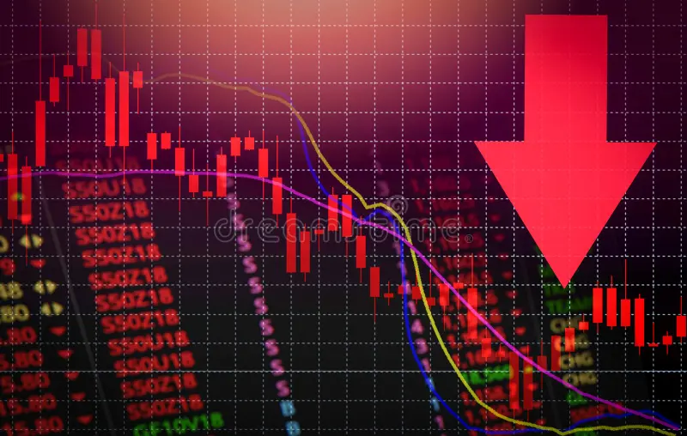
EXPLORING STOCK DATA WITH GRAPHS AND CHARTS
A Deep Dive into Visualization techniques from the stocks project

Slide 9


WHY USE GRAPHS AND CHARTS ?
Simplify complex data
Reveal hidden trends and outliers
Assist in decision making
Essential for financial analysis and stock predictions

Slide 10
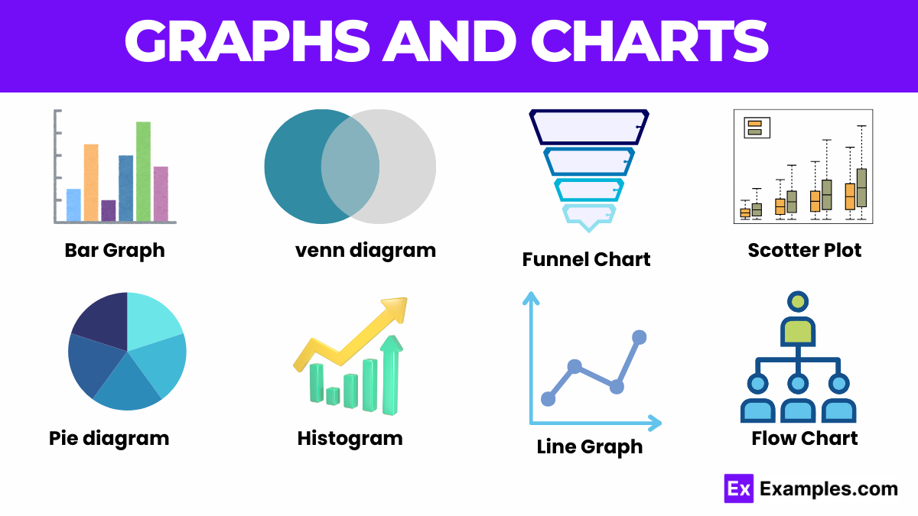
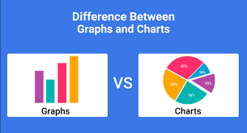
COMMON GRAPH TYPES IN STOCK ANALYSIS
LINE GRAPHS: Price movements over time
CANDLESTICK CHARTS: Open, high, low, close in a visual block.
HISTOGRAMS: Distribution of returns
SCATTER PLOTS: Correlation analysis

Slide 11
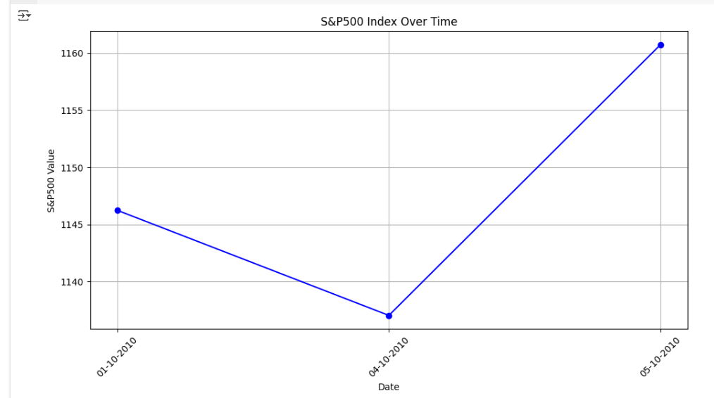
LINE CHART
This line chart visualizes the S&P500 Index over a short period in
October 2010.
TREND OVERVIEW: The chart shows the S&P500 Index’s performance
over three days in October 2010 (01-10-2010 to 05-10-2010), highlighting
a brief decline followed by a recovery.
PRICE MOVEMENT: The S&P500 starts at 1146.24 on 01-10-2010, dips to
a low of 1137.03 on 04-10-2010, and then rises to 1160.75 by 05-10-2010,
indicating volatility over this period.
SHORT-TERM VOLATILITY: The chart captures a V-shaped pattern, with
a noticeable drop of about 9 points (0.8%) in the first interval,
followed by a sharp increase of 23.72 points (2.1%) in the next,
reflecting short-term market fluctuations.
DATA POINTS: With only three data points, the chart provides a limited
snapshot, but it suggests an overall upward movement in the S&P500
Index by the end of the period, closing higher than the starting value.

Slide 12
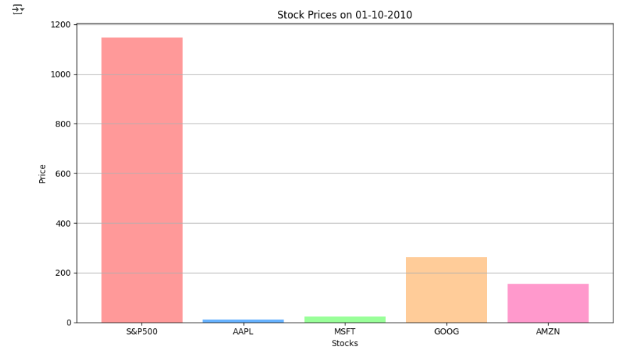
BAR CHART
STOCK PRICE COMPARISON: The bar chart compares the
prices of five
stocks—S&P500, AAPL, MSFT, GOOG, and AMZN—on
01-10-2010, highlighting significant price differences.
S&P500 DOMINANCE: The S&P500 Index has the highest
value at 1146.24, towering over individual stocks, reflecting
its role as a broad market index compared to individual
company stocks.
VISUAL CONTRAST: The chart uses distinct colors for each
stock (e.g., red for S&P500, light blue for AAPL, green for
MSFT), making it easy to differentiate the price levels, with
S&P500’s bar being the tallest by far.

Slide 13
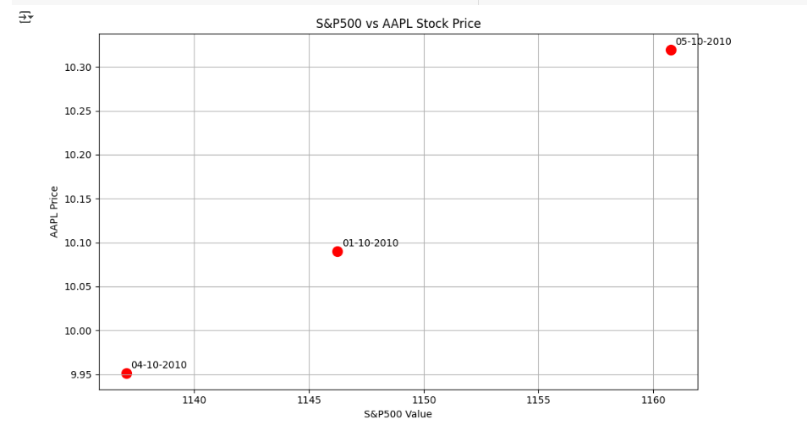
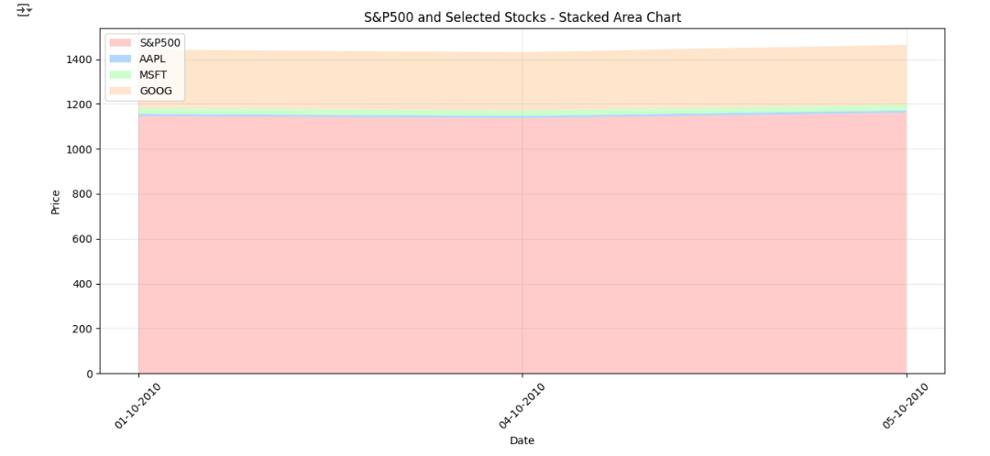
SCATTER PLOT AND AREA CHART
S&P500-AAPL CORRELATION (SCATTER): The scatter plot shows AAPL prices rising
from 9.95 to 10.32 as S&P500 moves from 1137.03 to 1160.75 (01-10-2010 to
05-10-2010), suggesting a potential correlation.
PRICE MOVEMENT (SCATTER): S&P500 dips to 1137.03 on 04-10-2010 (AAPL at
9.95) and rises to 1160.75 by 05-10-2010 (AAPL at 10.32), indicating synchronized
growth.
S&P500 DOMINANCE (AREA CHART): The stacked area chart highlights
S&P500’s dominance (e.g., 1146.24 on 01-10-2010)over AAPL, MSFT, and GOOG,
which contribute minimally to the total.
CONSISTENT TRENDS (BOTH): Both charts show a S&P500 dip on 04-10-2010 and
recovery by 05-10-2010, with the scatter plot focusing on AAPL and the area chart
on broader market trends.

Slide 14
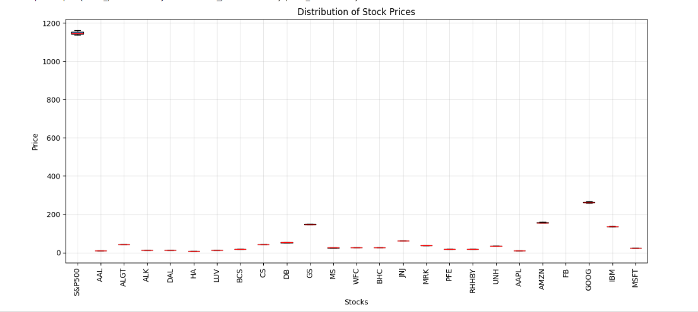
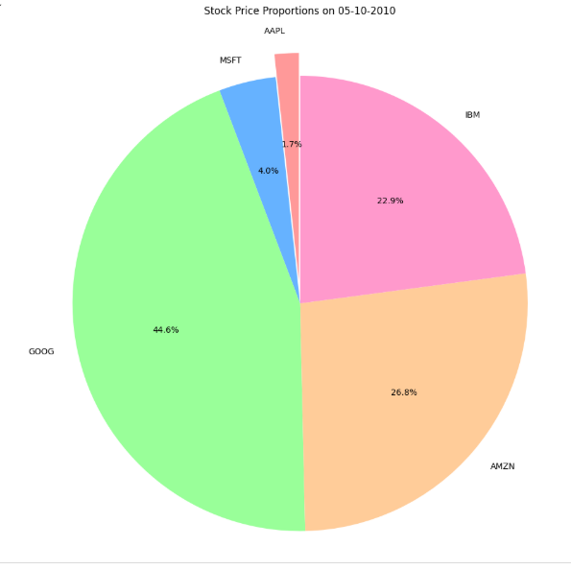
BOX PLOT AND PIE CHART
PRICE SPREAD (BOX PLOT): The box plot shows the distribution of
prices across all stocks, with S&P500 at 1137.03–1160.75, GOOG at
261.83, and most stocks (e.g., MSFT at 24.38) below 100, highlighting
a wide price range.
OUTLIER HIGHLIGHT (BOX PLOT): S&P500 and GOOG are outliers
in the box plot, with prices far higher than others (e.g., AAPL at
153.71, MSFT at 24.38), indicating significant variation in stock values.
PROPORTIONS (PIE CHART): The pie chart on 05-10-2010 shows
GOOG leading at 44% (261.83), followed by AMZN at 26% and IBM at
22.9%, with AAPL (4.0%) and MSFT (1.7%) having smaller shares.
DATA CONSISTENCY (BOTH): Both charts exclude S&P500 from the
pie chart and AMZN from the box plot due to data issues, focusing on
individual stocks’ price distributions and proportions on the last date.

Slide 15
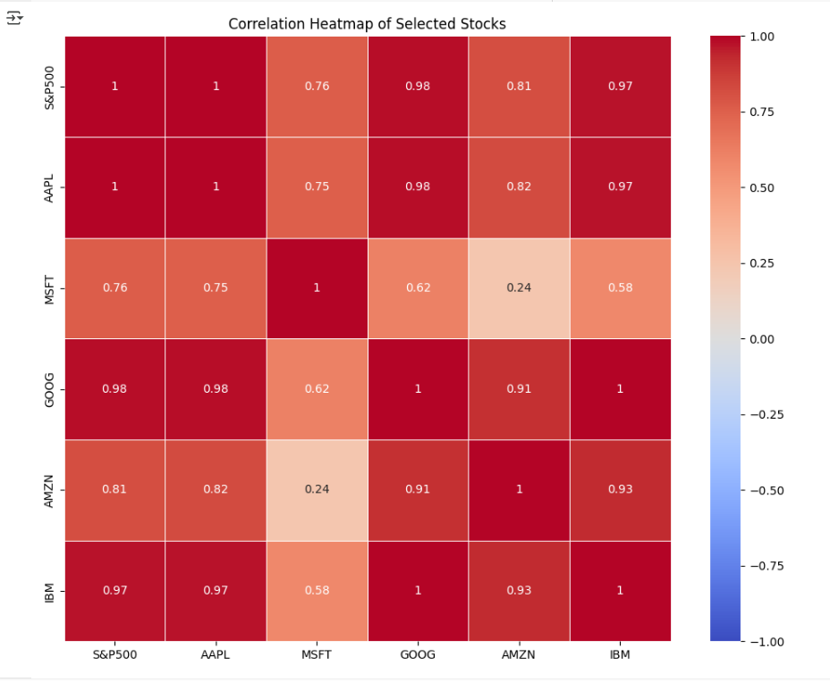
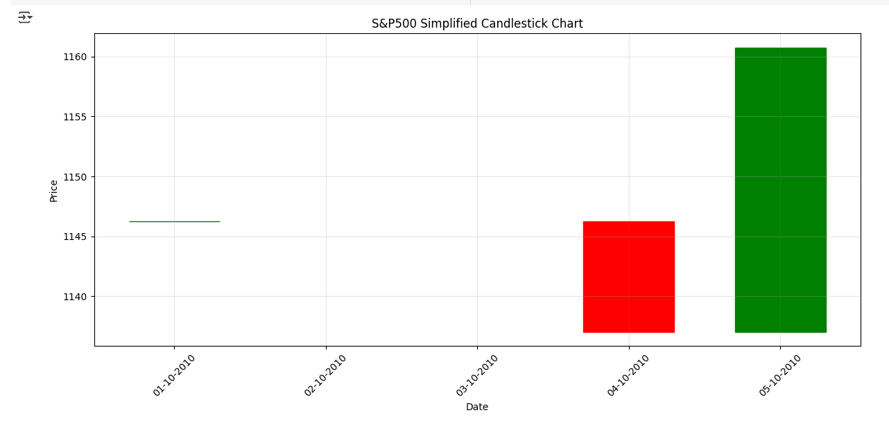
SOME MORE CHARTS
HEATMAP: CORRELATION BETWEEN SELECTED STOCKS Candlestick Chart

Slide 16

VISUALIZATIONS LIBRARIES USED
• MATPLOTLIB: Fundamental plotting library in Python.
• SEABORN: High-level interface for attractive statistical graphics.
• MPLFINANCE: Specialized for financial candlestick and OHLC charts.

Slide 17
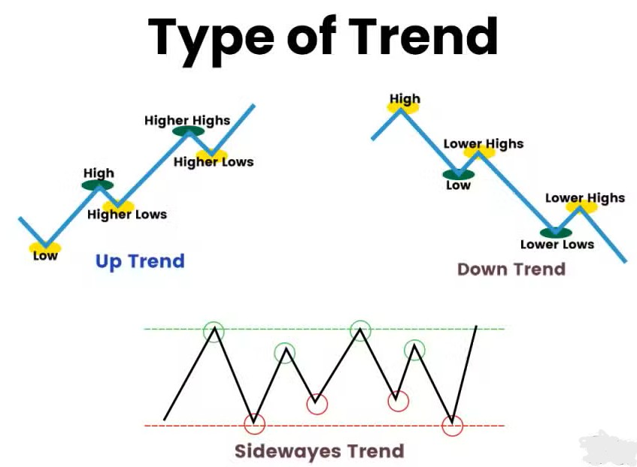
INTERPRETING STOCK DATA VISUALS
• UPTREND: Higher highs and higher lows.
• DOWNTREND: Lower highs and lower lows.
• SIDEWAYS TREND: Flat or range-bound prices.
• Volume spikes can confirm price movement strength.

Slide 18
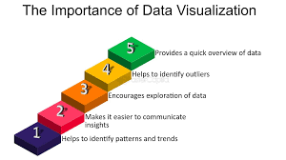

CONCLUSION
• Visualizations are critical for stock data insights.
• Charts reveal patterns not obvious from raw numbers.
• Helps traders and analysts make informed decisions.
• Understanding visuals is key to financial data literacy.

Slide 19
THANKYOU!!

